Slide 1

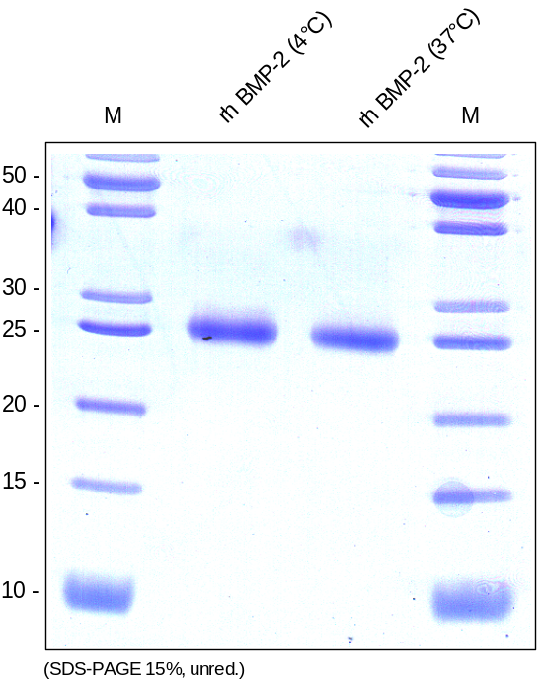
ReliaTech GmbH
Stability of recombinant human BMP-2
(Cat# 200-002)
Note: The BMP-2 was reconsituted at September 2, 2013 and checked by SDS-PAGE. The reconstituted protein was stored at 4°C and checked again by SDS-PAGE after 1, 2 and 4 weeks, respectively. Another test was performed after 9 weeks (05.11.2013). The remaining protein was splitted at November 11, 2013, 1 vial was stored 4°C the other at 37°C over the weekend. The protein is still OK.
http://www.reliatech.de / orders@reliatech.de

